Slide 1

E-LEARNER
Shubham Gupta(20BCS7538)
Megha Joshi(20BCS7950)
Saumya Saloni(20BCS7542)
Pragya Srivastav(20BCS7528)

Slide 2

INTRODUCTION
Recently e-learning systems are experiencing rapid development.
The advantages of learning through a global network are manifold and obvious:
the independence of time and space, learners can learn at their own pace,
learning materials can be organized in one place and used-processed all
around the world.
The personalization options increase efficiency of e-learning, thus justifying
the higher initial cost of their construction. In order to personalize the learning
process and adapt content to each learner, e-learning systems can use strategies that have the ability to meet the needs of learners.
Also, these systems have to use different technologies to change the environment and perform the adaptation of teaching materials based on the needs of learners.

Slide 3

OBJECTIVES
Enhance the quality of learning and teaching.
Meet the learning style Or needs of students.
Improve the efficiency and effectiveness.
They help to clarify, organize and prioritize learning.

Slide 4

Languages and Software Used
HTML
HTML stands for Hyper Text Markup Language. It is the standard markup language for Creating Web pages. It describes the structure of a Webpage. It consists of a series of elements. HTML elements tell the browser how to display the content.HTML elements label pieces of content such as "this is a heading", "this is a paragraph", "this is a link", etc.
2. CSS
CSS stands for Cascading Style Sheets. CSS describes how HTML elements are to be displayed on screen, paper, or in other media. CSS saves a lot of work. It can control the layout of multiple web pages all at once. External stylesheets are stored in CSS files.

Slide 5
3.JAVASCRIPT
JavaScript often abbreviated as JS, is a programming language that conforms to the ECMAScript specification. JavaScript is high-level, often just-in-time compiled, and multiparadigm. It has curly-bracket syntax, dynamic typing, prototype-based object-orientation, and first-class functions.
Alongside HTML and CSS, JavaScript is one of the core technologies of the Worldwide Web. JavaScript enables interactive web pages and is an essential part of web applications.
4. Php
PHP is a general-purpose scripting language that is especially suited to web development. It was originally created by Danish-Canadian programmer Rasmus Leadoff in 1994; the PHP reference implementation is now produced by The PHP Group.

Slide 6
5. MYSQL
SQL is a standard language for accessing and manipulating databases.
SQL stands for Structured Query Language.
SQL can execute queries against a database, retrieve data, insert records in a database, update records ,delete records, create new databases, create new tables in a database, create stored procedures in a database, create views in a database, set permissions on tables, procedures, and views.
SOFTWARES
1.XAMPP
2.VS-CODE

Slide 7

KEY FEATURES
Variety of study way
Worldwide Distibution and Sharing
Flexibility of Study
Application Forms
Fun zone

Slide 8
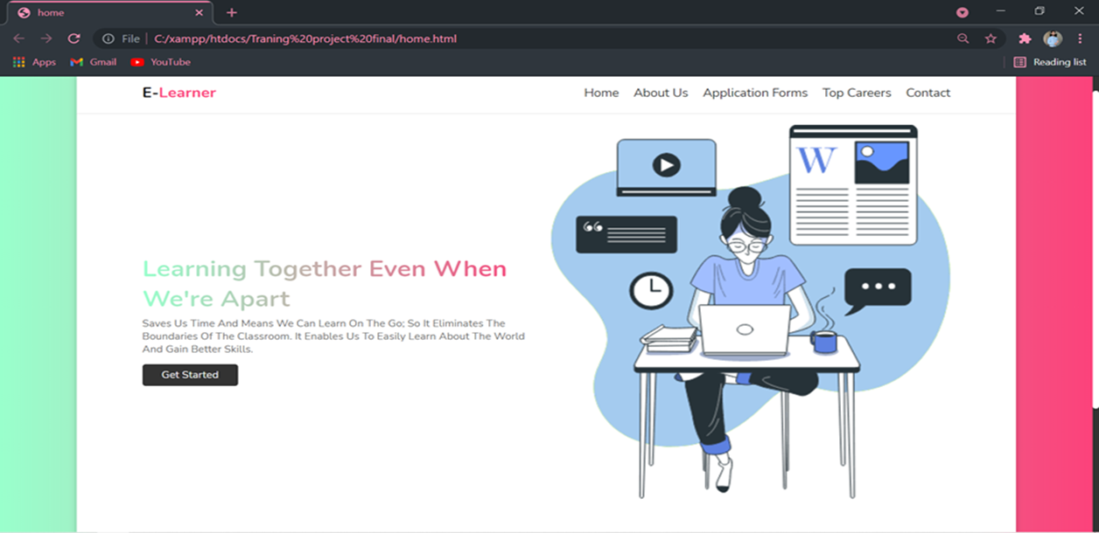
HOMEPAGE

Slide 9
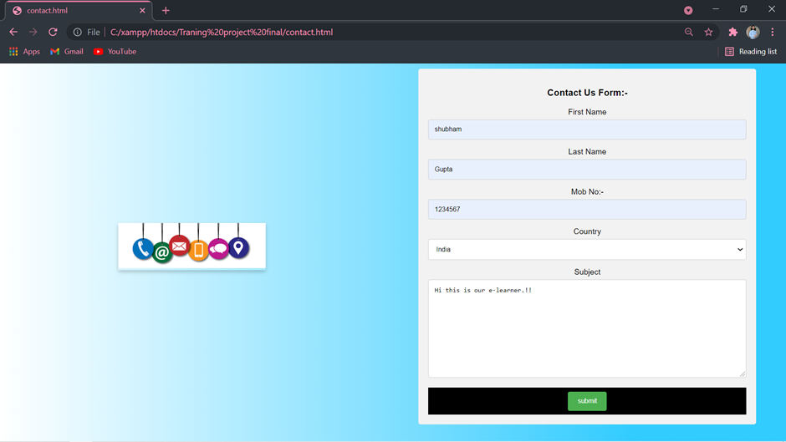
Contact Form

Slide 10
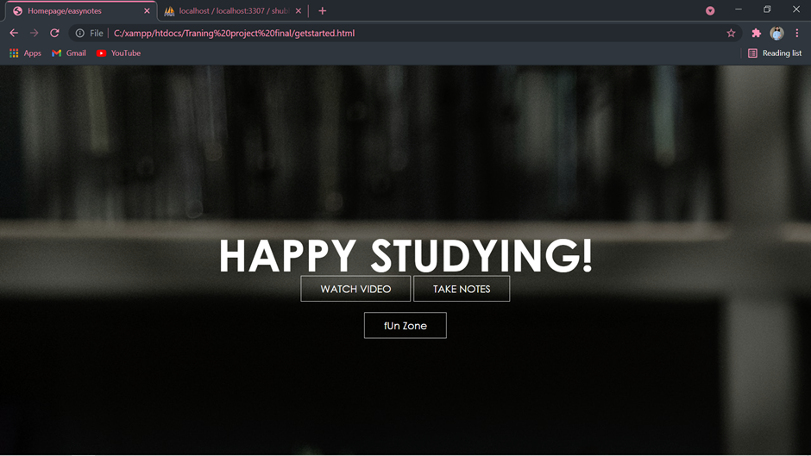
GET STARTED

Slide 11
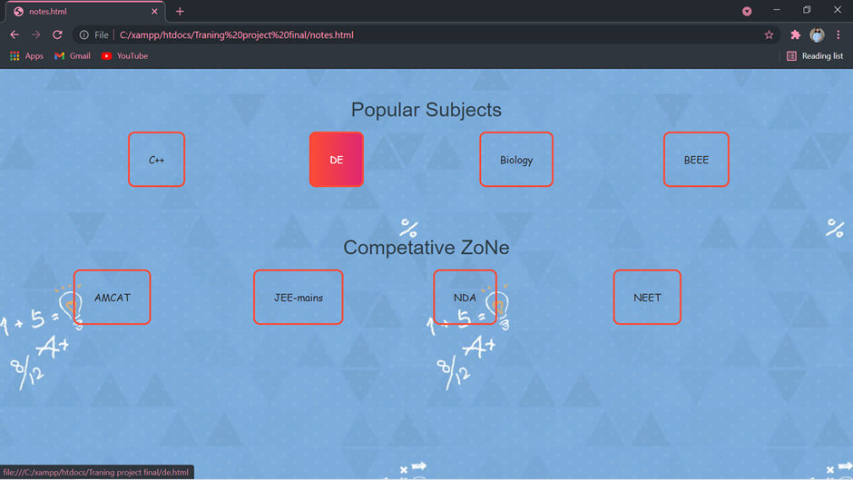
NOTES

Slide 12
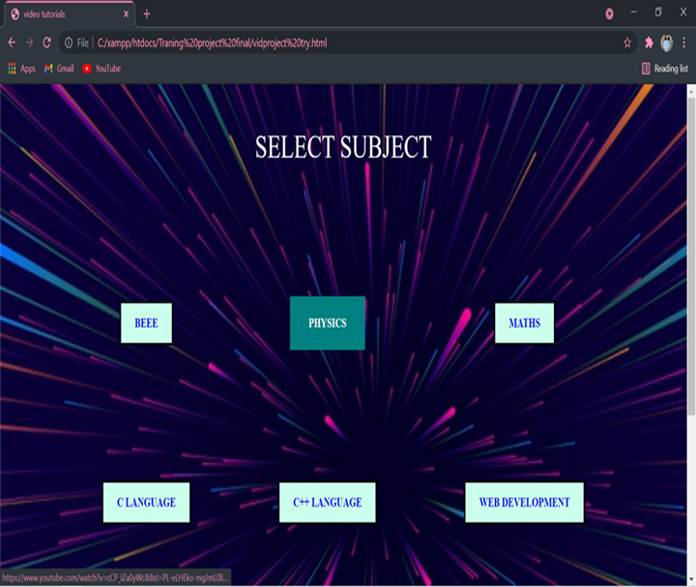
VIDEO TUTORIALS

Slide 13
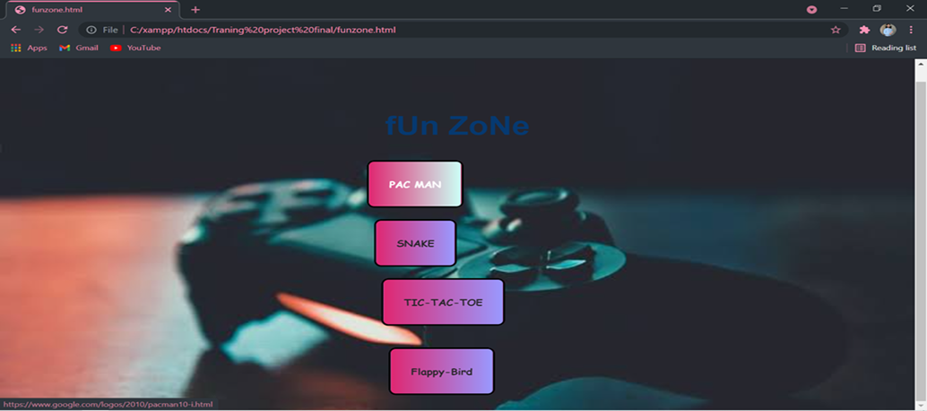
FUNZONE!!

Slide 14
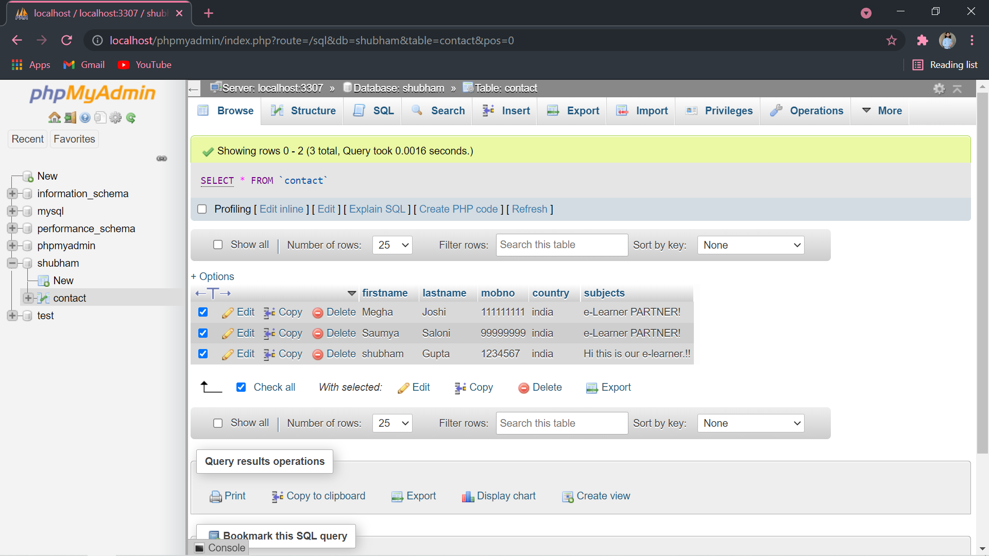
Database

Slide 15
FUTURE SCOPE
E learning has rapidly evolved from a thing of the future to a practical approach towards education.
It will continue to be an extremely useful classroom teaching tool as well as self-study platform.
With the rise of virtual reality technology and augment reality solutions, experimental subjects, skill-based learning and military training will come to depend more heavily on e-learning solutions.
It innovative approaches to team up.

Slide 16
CONCLUSION
E-learning has brought a positive impact in the lives of students and working
professionals. It has given an opportunity to take up additional courses along
with their studies or job as per their convenience. Online education has also helped the faculty in the institutions to ask students to study some part of syllabus online which do not require much of classroom instructions. So the online study helps the faculty to save time in which they can interact with the students more.
The quality of education has improved by online courses and even it has become easy for students to refer the content as per their leisure. In the era of digitalization the scope of online education increase even more and will be
beneficial for students, professionals and also institutions.

Slide 17


